Slide 1
Periodic Refresh

Slide 2
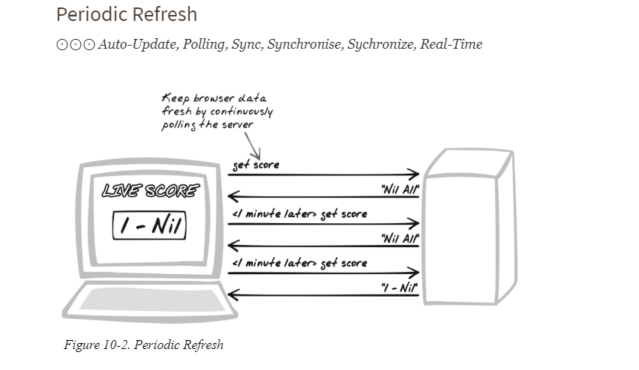

Slide 3
Developer Story
Devi’s coding up a ticket sales web site. For each event, she wants to keep the browser updated with the number of tickets remaining. Thus, she introduces a timer so that every 30 seconds, it calls a web service to pull down the latest sales stats.
Problem
How can the application keep users informed of changes occurring on the server?
Forces
The state of many web apps is inherently volatile. Changes can come from numerous sources, such as other users, external news and data, results of complex calculations, and triggers based on the current time and date.
HTTP requests can only emerge from the client. When a state change occurs, there’s no way for a server to open connections to interested clients.
One way to keep the browser updated is HTTP Streaming (Chapter 6), but, as the “Alternatives” section for that pattern explains, it’s not always ideal. In particular, it’s not very scalable.

Slide 4
Solution
The browser periodically issues an XMLHttpRequest Call to gain new information; e.g., one call every five seconds. The solution makes use of the browser’s Scheduling capabilities to provide a means of keeping the user informed of latest changes.
In its simplest form, a loop can be established to run the refresh indefinitely, by continuously issuing XMLHttpRequest Calls
setInterval(callServer, REFRESH_PERIOD_MILLIS);
Here, the callServer function will invoke the server, having registered a callback function to get the new information. That callback function will be responsible for updating the DOM according to the server’s latest report.

Slide 5
Periodic Refresh, is a serious compromise, for two key reasons:
The period between refreshes would ideally be zero, meaning instant updates. But that’s not realistic and the browser will always lag behind. Latency is particularly problematic when the user is interacting with a representation of volatile server-side data. For instance, a user might be editing an object without knowing that another user has already deleted it
There is a significant cost attached to Periodic Refresh. Each request, no matter how tiny, demands resources at both ends, all the way down to operating-system level. Traffic-wise, each request also entails some bandwidth cost, which can add up if refreshes are occurring once every few seconds.

Slide 6
Decisions
How long will the refresh period be?
The refresh period can differ widely, depending on usage context.

Slide 7
Demo

